Slide 1
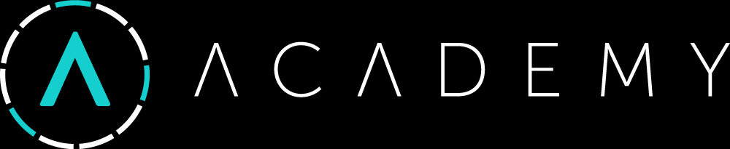

Privacy Coins
Zcash, Hush, Dash, PIVX, Monero, Verge, Bytecoin
Sevgin Mustafov
Blockchain Developer & Course Developer
Academy School of Blockchain
http://kingsland.academy

Slide 2



Table of Contents
Zero-Knowledge Proofs and zk-SNARKs
Zcash
Hush
Dash
PIVX
Monero
Verge
Bytecoin

Slide 3
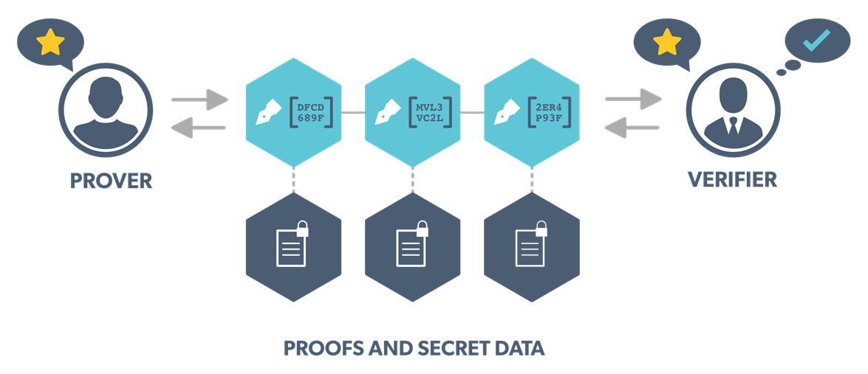
Zero-Knowledge Proofs
Proof You Know Something, without Revealing It

Slide 4
Zero-Knowledge Proof
Zero-knowledge proof
A proof that a someone knows something, without revealing it
Provers generate proof (and hide secret info)
Verifiers verify the proof (without revealing the secret info)
Interactive zero-knowledge proof
Prover convinces a verifier that the prover knows a secret
Sequence of interactions (exchanged messages) between them
Non-interactive zero-knowledge proof
A proof that does not need to interact between the parties

Slide 5
Zero Knowledge Proofs
Completeness – if the statement is true, the honest verifier will be convinced
Soundness – if the statement is false, no cheating prover can convince the honest verifier that it is true
Zero-knowledge – no verifier learns anything other than the fact that the statement is true
Non-interactive zero knowledge proofs
Data verified without interaction from the prover
Zero-knowledge proofs can guarantee the validity of transactions
Without revealing what's inside the transactions

Slide 6

Zero Knowledge Proofs Example
You have a function C taking two inputs: C(x, w)
x is the public input
w is the secret witness input
Output is boolean (true / false)
Goal: given a specific public input x, prove that the prover knows a secret input w such that C(x, w) == true
Typical function C(x, w) is: SHA256(w) == x

Slide 7
Zero Knowledge Proof Protocols
Schnorr protocol
Proof of knowledge of a discrete logarithm (works with ECC)
http://www.lsv.fr/Software/spore/schnorr.pdf
zk-SNARKs
Zero-knowledge proof cryptosystem used in Zcash
Zero-Knowledge Succinct Non-Interactive Argument of Knowledge
Build around the elliptic-curve cryptography (ECC)
https://z.cash/technology/zksnarks.html

Slide 8
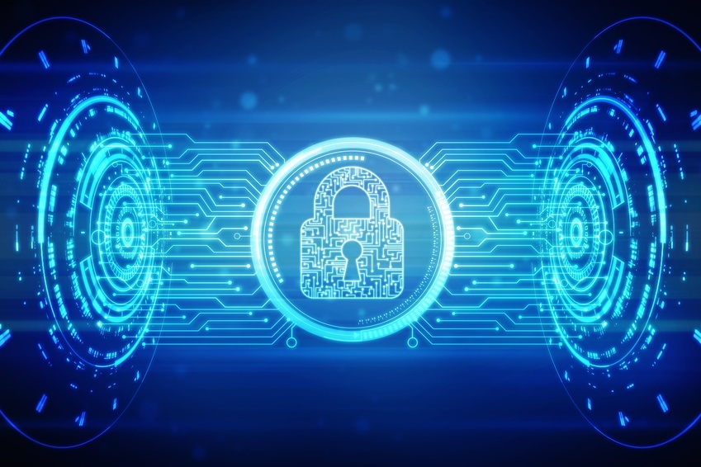
Privacy Coins
Zcash, Hush, Dash, PIVX, Monero, Verge, Bytecoin

Slide 9
Private Transactions
Privacy coins might hide different transaction elements
Hidden amounts in the transactions
E.g. the MimbleWimble protocol
https://github.com/mimblewimble/grin/blob/master/doc/intro.md
Hiding transaction addresses + amounts
Based on zero-knowledge proofs
E.g. the Zcash shielded transactions, based on zk-SNARKs

Slide 10
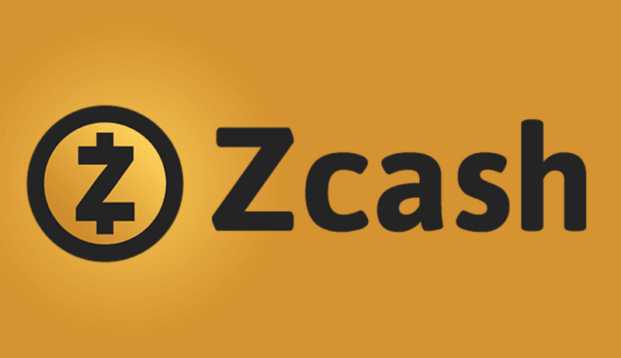
Zcash
How Zcash Works?

Slide 11
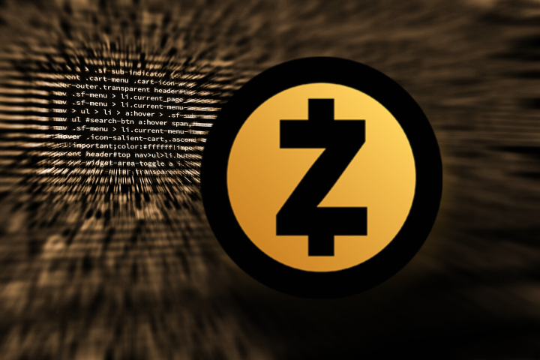
Zcash
Open, permissionless blockchain
Strong privacy protections
Proof of work hash algorithm: Equihash
Zero-knowledge cryptography
Selective transparency of transactions
"Shielded" transactions hide
Sender + Recipient + Value (see an example at Zchain Explorer)
All transactions published on a public blockchain
If Bitcoin is like http for money, Zcash is like https

Slide 12
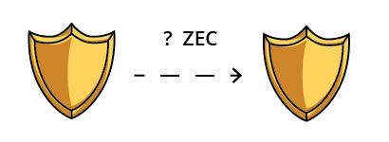
How Zcash Works?
Zcash encrypts the contents of shielded transactions
Payment information is encrypted
Novel cryptographic method is used to verify their validity
Transaction metadata is encrypted
Uses zk-SNARK to prove that nobody is cheating or stealing

Slide 13
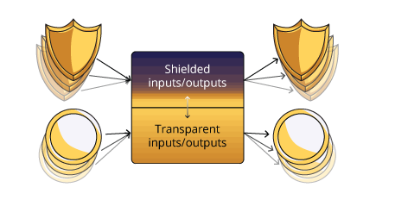
How Zcash Works? (2)
Enables users to send public payments
Similarly to Bitcoin
Supports both shielded and transparent addresses
Send privately or publicly
Payments
Shielded address → transparent address reveal the received balance
Transparent address → shielded address protect the receiving value

Slide 14
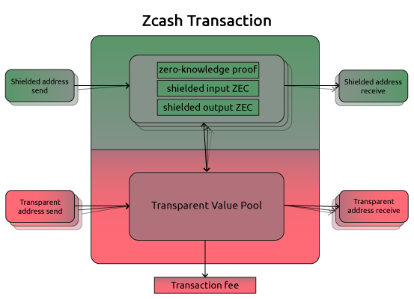
Building Blocks of a Transaction
Shielded address
Addresses start with a “z”
Requires the generation of a zero-knowledge proof
Transparent addresses
Addresses start with a “t”
Require interaction with “Transparent Value Pool” (TVP)
Transaction fee also passes through the TVP → always visible

Slide 15
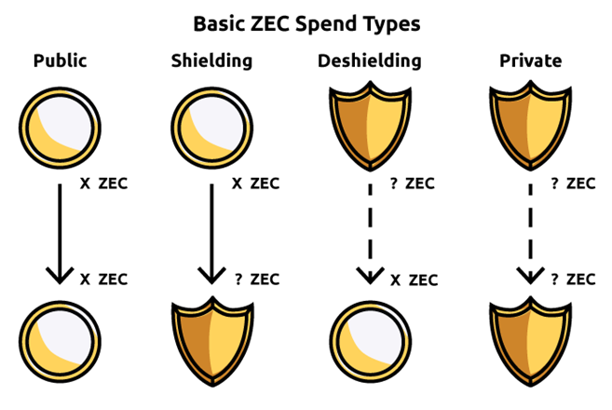
Sending Transactions Between Shielded and Transparent Addresses
ZEC – cryptocurrency of Zcash
Different set of properties depending on
Address type
Previous address(es)
Transparent address
Unspent balance → publicly viewable
Balance being sent to transparent, shielded addresses or combination output ZEC from a transparent address → visible
Sending transparent ZEC to a shielded address → breaking the linkability between future transparent addresses

Slide 16
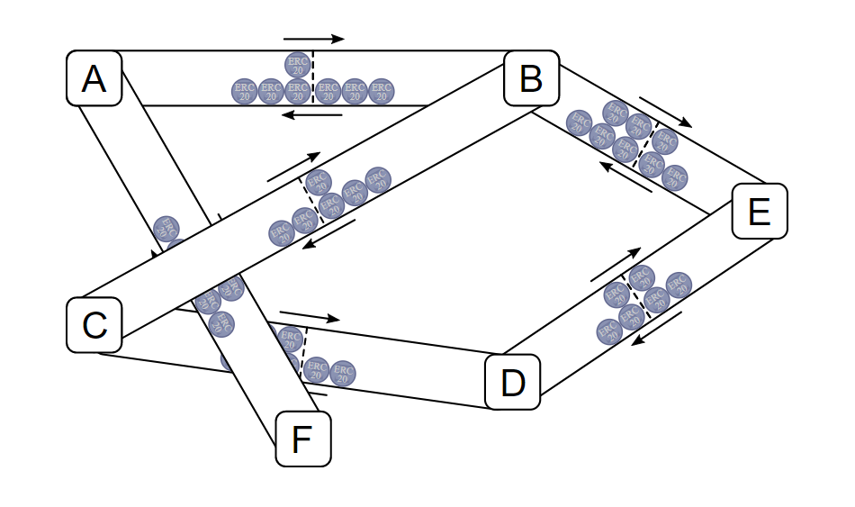
Private Payment Channels
Blind Off-chain Lightweight Transactions (BOLT)
Fast, private payment channel protocol inspired by the Lightning Network
No block confirmations
Eliminates the linkage between payments within a channel
Merchant know the channel he has opened and being paid
Payment channel (i.e. Lightning Network)
Escrow funds & resolve disputes, not private
Two protocols
Non-interactive
Interactive (bidirectional payments)

Slide 17
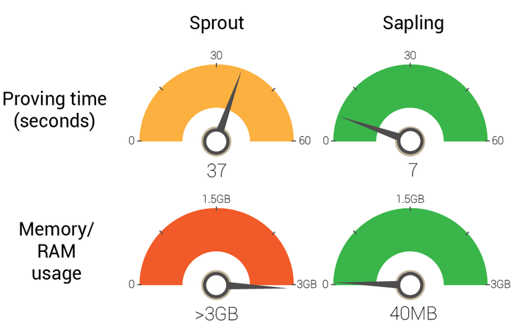
Cultivating "Sapling": Faster zk-SNARKs
Groundbreaking performance improvements for the shielded transactions
New “embedded” elliptic curve for zk-SNARKs – Jubjub
Curve of the form: -x²+y²=1+dx²y²
Built over the BLS12-381 scalar field, with d=−(10240/10241)
Use more efficient primitives for
Commitment schemes
Collision-resistant hashes
80% reduction of proving time
98% reduction in memory usage

Slide 18
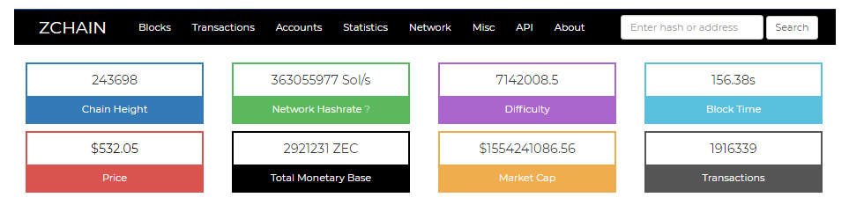
Live Demo
Zcash Block Explorer
https://explorer.zcha.in

Slide 19
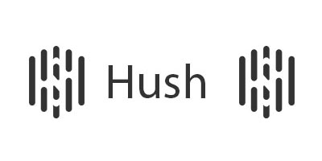
Hush
How Hush Works?

Slide 20

Hush
Based on Bitcoin's code
Private implementation of the Zerocash protocol forked from Zcash
Trusted setup as the Zcash’s methodology
Burning of private keys
Sophisticated zero-knowledge
Algorithm: Equihash
Block time: 2.5 minutes

Slide 21

Dash
How Dash Works?

Slide 22


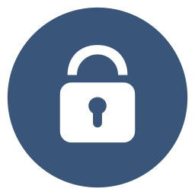
Dash
Instant
Private
Secure
Send and confirm payments in less than a second
Transactions confirmed by 200 TH of X11 ASIC
Protect your financial information

Slide 23
Dash (2)
Fully-incentivized peer-to-peer network
Instant Send (like a lightning network)
Private Send (like Zcash shielded transactions)
DAO with Decentralized Governance by Blockchain (DGBB)
Two-tier architecture:
Miners rewarded for securing and writing transactions to the blockchain
Proof of work algorithm: X11
Masternodes
Rewarded for validating, storing and serving the blockchain to users
Work in quorums

Slide 24
What are Masternodes?
Masternode == server connected to the network
Guarantees a certain minimum level of performance and functionality to perform certain tasks related to Private Send and Instant Send
Using Proof of Service (addition to the Proof of Work)
Allowed to vote on governance and funding proposals
Anyone can run a masternode
Proof of Ownership of 1000 Dash
Every 16,616 blocks (~ 28 days) – superblock is created
Randomly selected for payment

Slide 25
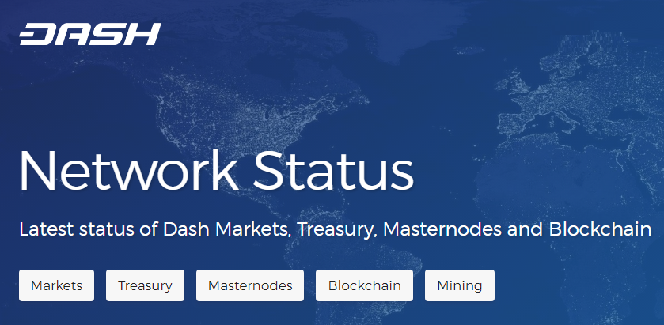
Dash – Live Demo
https://www.dash.org/network

Slide 26
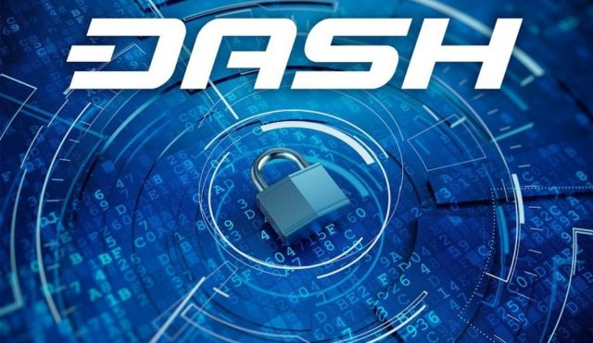
Exercise: Playing with Dash
Install Wallet, Get and Send Dashes

Slide 27

PiVX
How PiVX Works?

Slide 28

PIVX
Private Instant Verified Transaction (PIVX)
Decentralized, open-source, privacy-oriented cryptocurrency
PoW algorithm: Quark
Launched as Darknet (DNET)
Runs on the Blackcoin PoS 2.0 protocol
Based on a Bitcoin fork
100% Proof of Stake
Masternodes verify transactions
90% of rewards go to Masternodes and Proof of Stake nodes
10% going to community projects

Slide 29
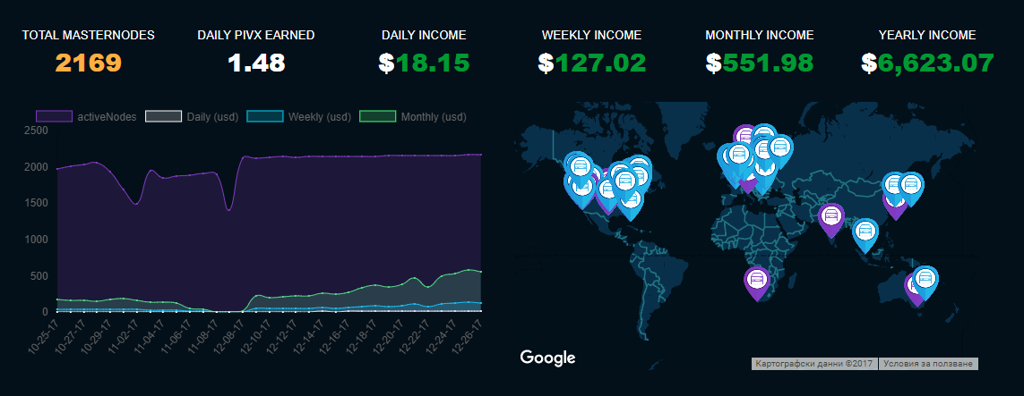
Live Demo
PIVX
http://www.presstab.pw/phpexplorer/PIVX/

Slide 30
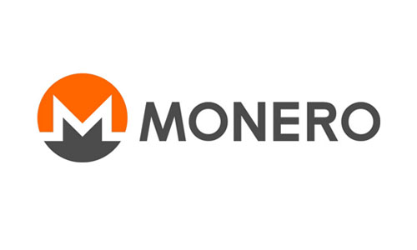
Monero
How Monero Works?

Slide 31

Monero
Secure
Private
Ring signatures
and confidential transactions
Immutably recorded

Slide 32

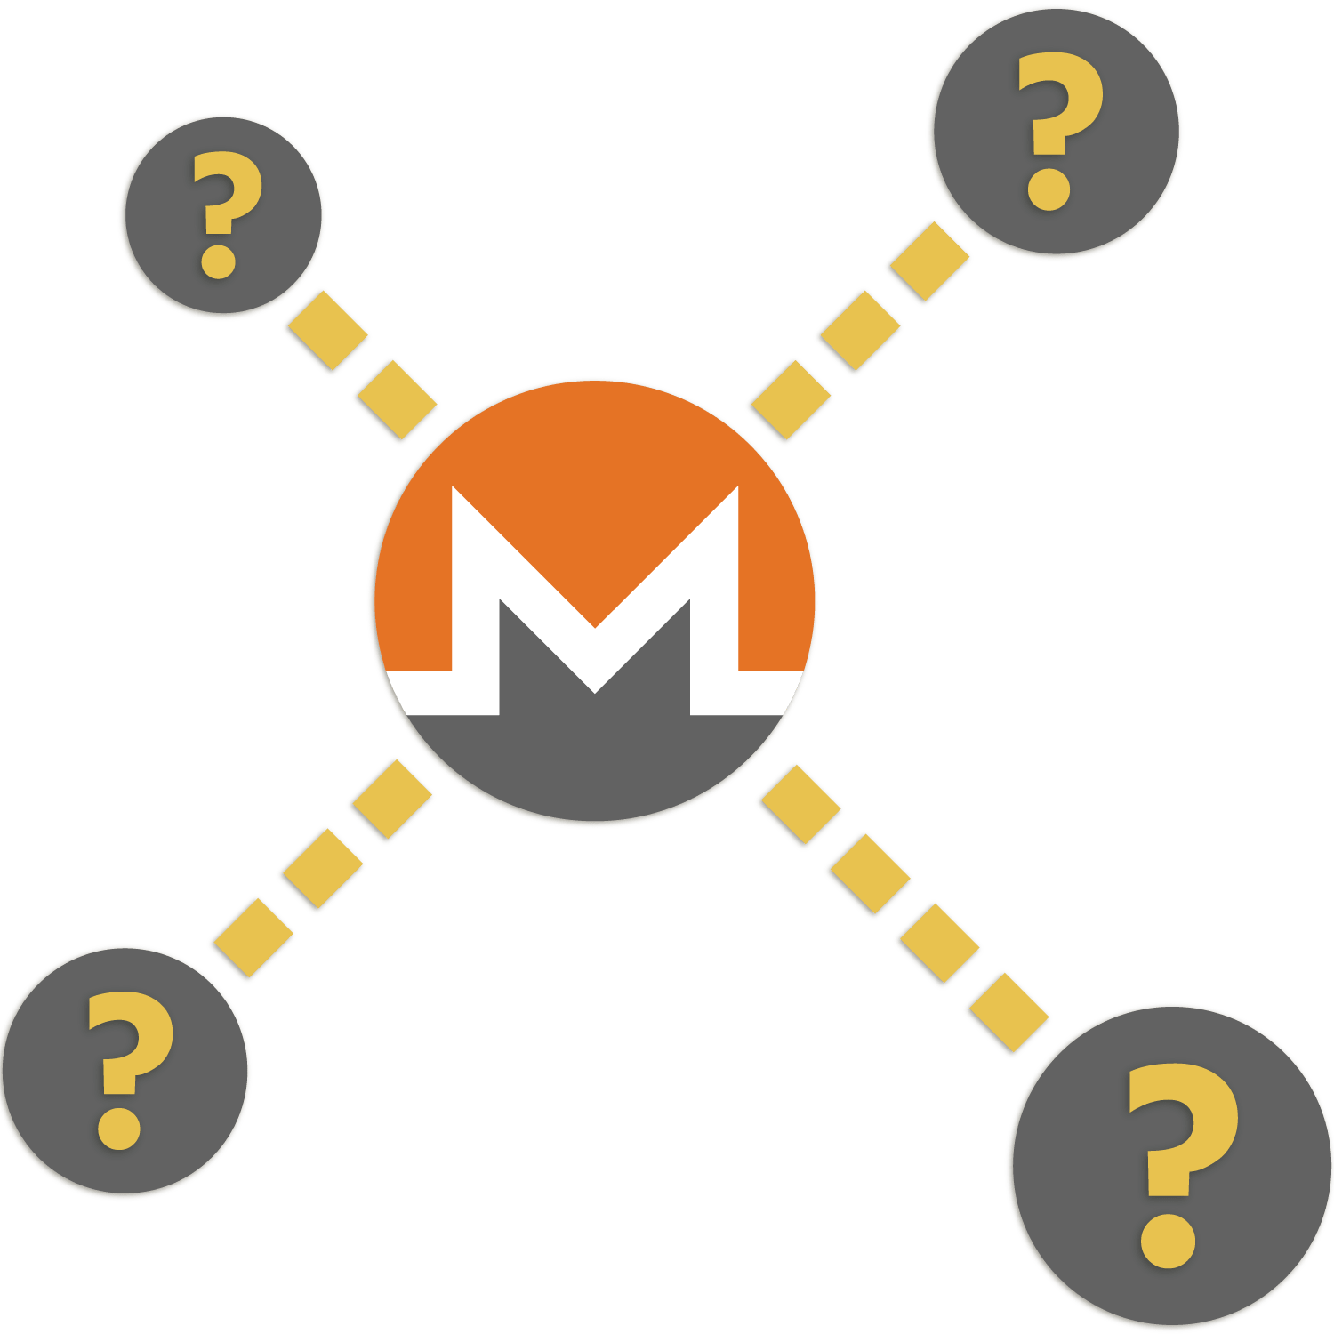
Monero (2)
Untraceable
Fungible
Transactions cannot be linked to a particular user
Units of Monero cannot be blacklisted by vendors

Slide 33

Live Demo
Monero Stats
https://moneroblocks.info/stats

Slide 34
How Does Monero Work?
PoW algorithm: CryptoNight
No one can tell how rich you are
Unlinkability – one-time address not linked to public address
Public address == randomly created brand new one-time destination address (send transaction)
Public record does not contain any mention that funds were received
Public address never appear in the public record of transactions
“Stealth address” recorded and only the recipient, can recognize the incoming funds
Secret view key is used to check each transaction by recipient

Slide 35
How Does Monero Work? (2)
Ring signatures enable “transaction mixing” to occur
Transaction mixing – obfuscation technique to make tracing very hard job
No one can tell which of the funds were really the source of the transaction
“Mixin” level
Larger mixin level == larger size of the transaction

Slide 36
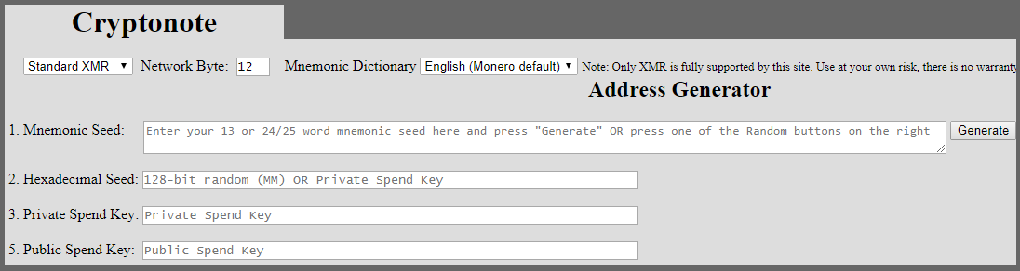
Live Demo
Monero (Cryptonote) Address Generation
https://xmr.llcoins.net

Slide 37
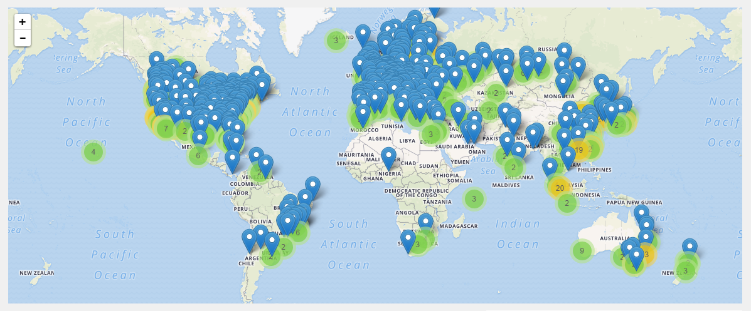
Live Demo
Monero Active Nodes Distribution
https://monerohash.com/nodes-distribution.html
Sample transaction: https://monerohash.com/explorer/tx/119fee2b667eb809310749e6df78314b00da418966e701784805df1ad140f875/1

Slide 38
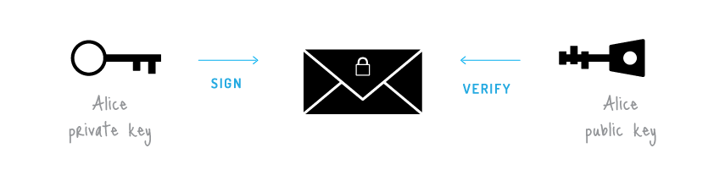
Ring Signatures: Untraceable Payments
The ordinary digital signature
Necessary condition but not always a sufficient condition
Verification process involves the public key of the signer
The signature proves that the author possesses the corresponding secret key

Slide 39
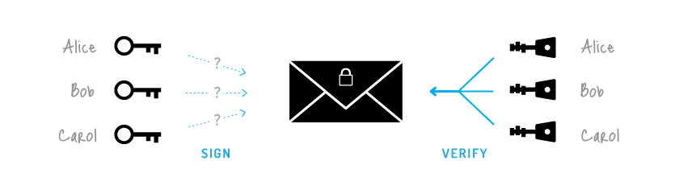
Ring Signatures: Untraceable Payments (2)
Ring signature - more sophisticated scheme
Several different public keys
Group of individuals
With own secret and public key
Proving the signer of a given message is a member of the group
Verifier cannot establish the identity of the signer

Slide 40
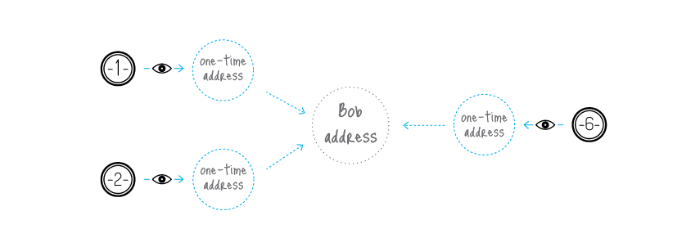
One-Time Keys: Unlinkable Transactions
Automatic creation of multiple unique one-time keys
Derived from the single public key
Modification of the Diffie-Hellman exchange protocol
Sender uses the receiver's public address and his own random data to compute a one-time key for the payment
Usage of random data by the sender → different one-time key

Slide 41

Double-Spending Proof
“Traceable ring signature” to “Linkability ring signature”
CryptoNote linkability
Special marker created by a user while signing (key image)
One-way function - given only the key image it is impossible to recover the private key
Computationally impossible to find a collision
All users keep the list of the used key images
Reject new ring signature with a duplicate key image

Slide 42
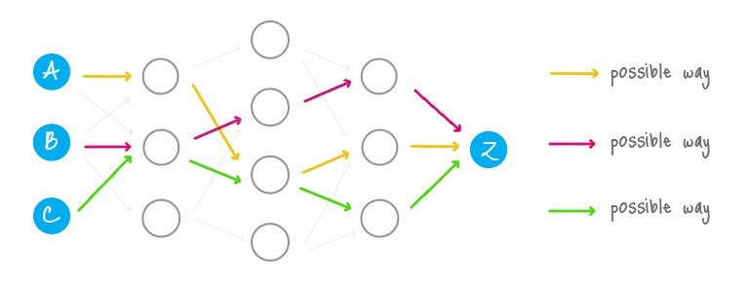
CryptoNote Blockchain Analysis Resistance
Mitigate risks associated with
Key re-usage
One-input-to-one-output tracing
Address for a payment
Unique one-time key
Derived from the sender's and the recipient's data
Graph without any cycles
Billions of possible graphs (ring signature produces ambiguity)

Slide 43
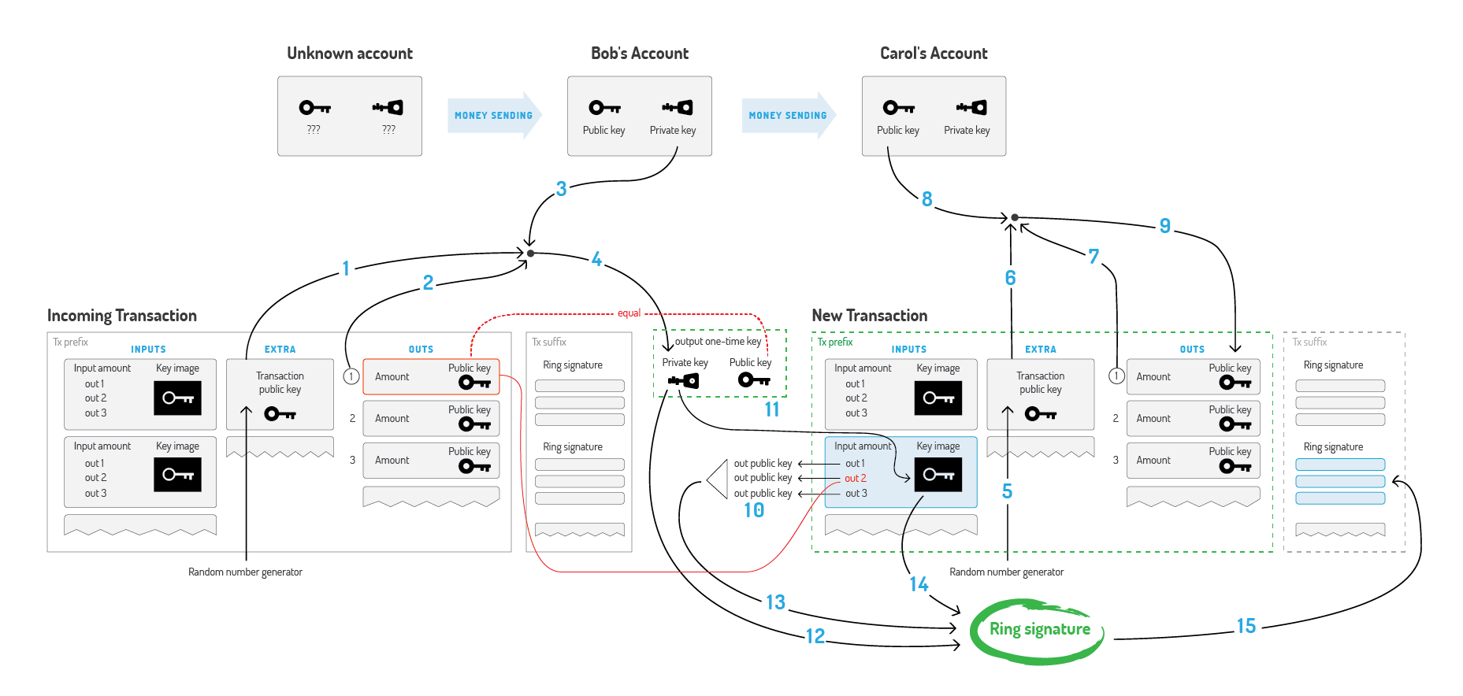
Standard CryptoNote Transaction

Slide 44
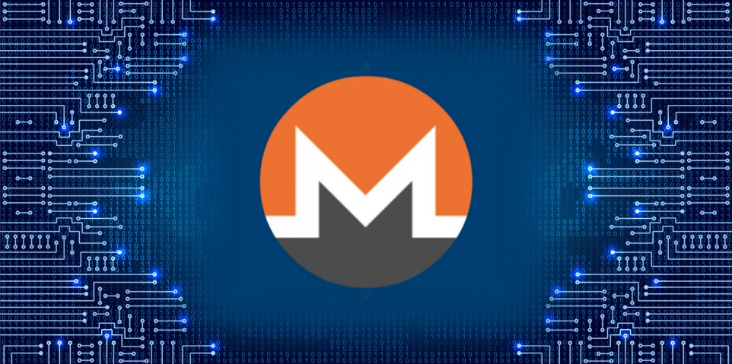
Exercise: Playing with Monero
Get and Send Monero

Slide 45

Verge
How Does Verge Work?

Slide 46

Verge
Privacy cryptocurrency
Focused on communication through protocols like I2p and Tor
5 Proof-of-Work algorithms
Scrypt
X17
Lyra2rev2
myr-groestl
blake2s
Algorithms have a 30-second block target block time
Difficulty influenced by the algorithms hash rate
P2P transaction support for Telegram and Discord
Future development to incorporate Rootstock (RSK)

Slide 47
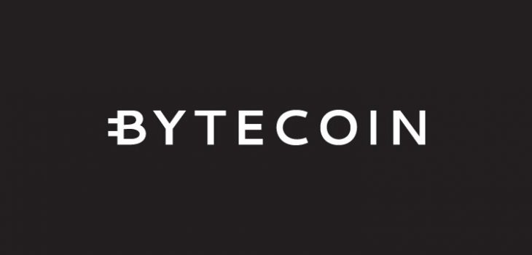
Bytecoin
How Does Bytecoin Work?

Slide 48
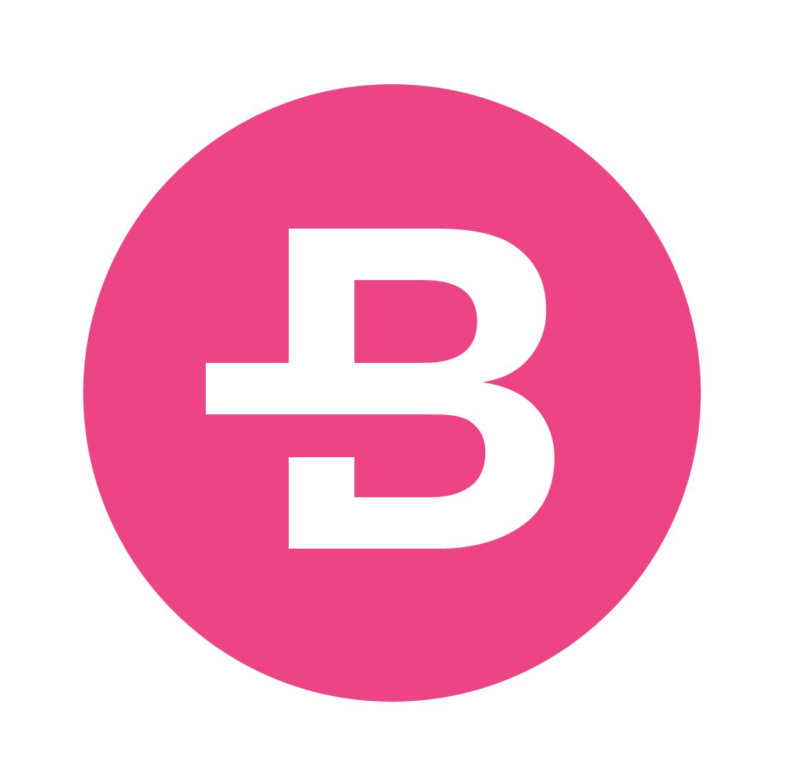
Bytecoin
The first private untraceable cryptocurrency with the CryptoNote technology
Instant private transactions
Totally untraceable
No additional fees
Limited to 184.47 billion BCN
Modular code base
Build application with source code modules
Powerful and flexible API
Multi-purpose and multi-layer
Multisignature

Slide 49

Summary
Zcash – Open, permissionless using zero knowledge cryptography
Private Payment Channels – Blind Off-chain Lightweight Transactions
Hush – Based on Bitcoin's code, Zcash’s methodology
Dash – Unique fully-incentivized peer-to-peer network
Masternodes – server connected to the network
PIVX – Private Instant Verified Transaction
Monero – Secure private untraceable currency
Ring Signatures - several different public keys
Verge – has 5 Proof-of-Work algorithms
Bytecoin – first private untraceable cryptocurrency with the CryptoNote technology

Slide 50
Privacy Coins
http://www.kingsland.academy

Slide 51
Resources
Zcash: https://z.cash/
How Zcash Works: https://z.cash/technology/
Building a Block of a Transaction: https://z.cash/blog/anatomy-of-zcash.html
Dash: https://dashpay.atlassian.net/wiki/spaces/DOC/pages/29360130/Introducing+Dash
Masternodes: https://dashpay.atlassian.net/wiki/spaces/DOC/pages/1146943/Masternodes
Privacy coins: https://coincentral.com/privacy-coins-what-are-they-how-do-they-work-and-why-are-they-needed/
Monero: https://getmonero.org/
CryptoNote: https://cryptonote.org/inside/
Privacy coins: https://coincentral.com/privacy-coins-what-are-they-how-do-they-work-and-why-are-they-needed/
Bytecoin: https://wiki.bytecoin.org/wiki/Main_Page

